Slide 1
Module 3
GNSS/INS Sensing for Pose Estimation

Slide 2
Module 3 | GPS & INS Sensing for Pose(ポーズ) Estimation
INS: inertial navigation system
In this module…
3D kinematics, important reference frames
Rotation representations
Inertial Measurement Unit (IMU)
Global Navigation Satellite Systems (GNSS)

Slide 3
Module 3 | Lesson 1
3D GEOMETRY AND REFERENCE FRAMES

Slide 4


Coordinate Rotations
Vectors can be expressed in different coordinate frames:
r
ℱ
r_{a}
r
a
ℱ
r_{b}
b
ℱ
a
The coordinates of the vector are related through a rotation matrix:
r_{b} = C_{ba}r_{a}
takes coordinates in frame a
and rotates them into frame b
ℱ
b

Slide 5





Transformations
P
_{r} pi
_{r} pv
ℱ
v
_{r} vi
ℱ
i
r ^{pi} = r ^{vi} + r ^{pv}
r^{pi} = r^{vi} + C_{iv}r^{pv}
i
i
v
i frame
v frame
全部i frame

Slide 6

How Can We Represent a Rotation?
1
Rotation matrix
_{Cba ∈ ℛ}3×3
r_{b} = C_{ba}r_{a}
b
1
b
2
b
3
緑枠の式から、この掛け算が分かりやすい
C_{ba} =
a a a
[
1
2
3]
C_{ba}C^{T} = C_{ba}C_{ab} = 1
ba
b ⋅ a
b ⋅ a b ⋅ a
1 1 1 2 1 3
b ⋅ a b ⋅ a b ⋅ a
This matrix defines the relationship between the basis vectors（基底「きてい」） of two reference frames in terms of dot products.
The Inverse of a rotation matrix is its Transpose.
“direction cosine matrix” (DCM)
=
2 1
2 2
2 3
b ⋅ a b ⋅ a b ⋅ a
3 1
3 2
3 3

Slide 7

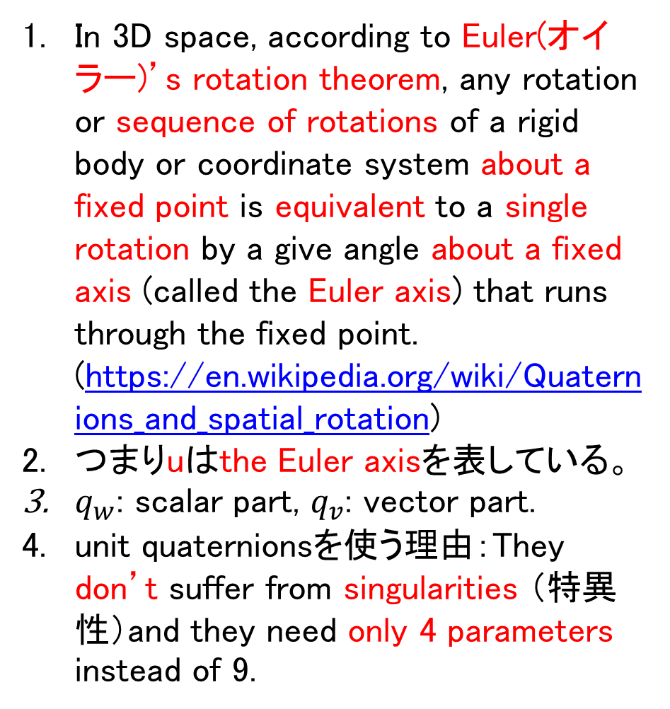
How Can We Represent a Rotation?
In 3D space, according to Euler(オイラー)’s rotation theorem, any rotation or sequence of rotations of a rigid body or coordinate system about a fixed point is equivalent to a single rotation by a give angle about a fixed axis (called the Euler axis) that runs through the fixed point. (https://en.wikipedia.org/wiki/Quaternions_and_spatial_rotation)
つまりuはthe Euler axisを表している。
$q_{w}$: scalar part, $q_{v}$: vector part.
unit quaternionsを使う理由：They don’t suffer from singularities （特異性）and they need only 4 parameters instead of 9.
2
Unit quaternions（クォータニオン、四元「しげん」数）
r
u
q
cos ^{ϕ}
q =
[
w
]
=
2
ϕ
q
v
û sin ^{ϕ}
2
ϕ
∥q∥ = 1
r_{b} = C(q_{ba})r_{a}
C(q) = (q² − q^{T}q )1 + 2q q^{T} + 2q [q ]
w v v v v w v ×
0 −a_{z} a_{y} a_{z} 0 −a_{x}
−a_{y} a_{x} 0
where
[a]× =
QuaternionをRotation matrixに変換する式
Rotation matrixをQuaternionに変換する式はhttp://www.euclideanspace.com/maths/geometry/rotations/conversions/matrixToQuaternion/

Slide 8
Quaternion Multiplication and Rotations
Quaternions multiplication is a special operation that is associative（結合的） but is not commutative（可換的） in general (just like matrix multiplication!):
p_{w} q_{w} − p^{T}q
p ⊗ q =
quaternion product operator
[
v v
]
p q + q p + [p ] q
w v w v
v × v
Sequential rotation operations can also be performed by taking advantage of quaternion multiplication:
C(p ⊗ q) = C(p) C(q)

Slide 9
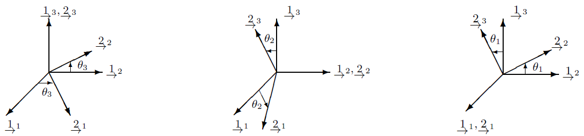
How Can We Represent a Rotation?
These angles represent an arbitrary rotation as the composition of 3 separate rotations about different principle axes(主軸).例えば、z, y, x軸。
課題：Euler angle representations are subject to what are called singularities.
Singularities（特異性） complicate state estimation because they represent particular rotations from which two Euler angles are indistinguishable.
Neither quaternions nor rotation matrices suffer from this problem at the expense of using more parameters.
3
Euler angles（オイラー角）
C(θ₃, θ₂, θ₁) = C₃(θ₃) C₂(θ₂) C₁(θ₁)
about the 3-axis
about the 2-axis
about the 1-axis
cos θ₃ −sin θ₃ 0
sin θ₃ cos θ₃ 0
0 0 1
cos θ₂ 0
−sin θ₂
0 sin θ₂
1 0
0 cos θ₁
0 sin θ₁
0
−sin θ₁
cos θ₁
C₃ =
C₂ =
1 0
0 cos θ₂
C₁ =

Slide 10
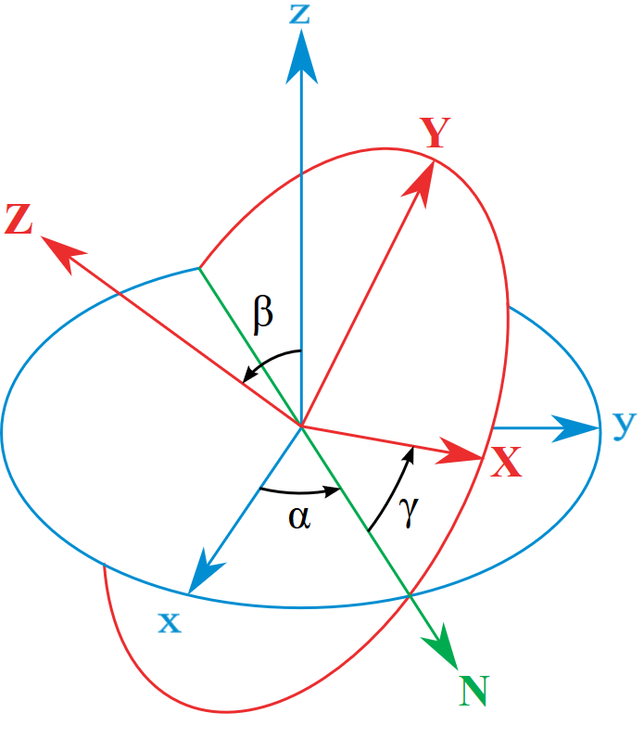
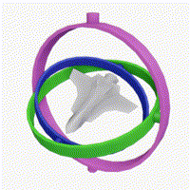
オイラー角の特異性について（僕の理解で、特異性という言葉は、答えが唯一に特定できない場合で使う。）
The angles α, β and γ are uniquely determined except for the singular case that the xy and the XY planes are identical, i.e. when the z axis and the Z axis have the same or opposite directions.
Indeed, if the z axis and the Z axis are the same, β = 0 and only (α + γ) is uniquely defined (not the individual values), and, similarly, if the z axis and the Z axis are opposite, β = π and only (α − γ) is uniquely defined (not the individual values). These ambiguities are known as gimbal（ジンバル） lock in applications. （z軸とZ軸がalignしたら、αやγ（がんま）が同じ平面での回転になってしまって、分けられない）
https://en.wikipedia.org/wiki/Euler_angles
(https://en.wikipedia.org/wiki/Rotation_matrix) The problem of singular alignment, the mathematical analog of physical gimbal（ジンバル） lock, occurs when the middle rotation aligns the axes of the first and last rotations.
https://en.wikipedia.org/wiki/Gimbal_lock
右の図で、真ん中の緑回転のせいで、マゼンタと青回転の軸が同じになる。１つ自由度が失った。

Slide 11
Which Rotation Representation Should I Use?
Rotation Matrix
Unit quaternion
Euler angles
cos ^{ϕ}
Expression
C
q =
2
{θ₃, θ₂, θ₁}
û sin ^{ϕ}
2
Parameters
9
4
3
Constraints
CC^{T} = 1
| q | = 1
None*
回転行列の行列式も必ず１
Singularities?
No
No
Yes!
To use a unit quaternion to actually rotate a vector, also require some additional algebra beyond simple matrix multiplication.
Euler angles are intuitive to visualize.

Slide 12
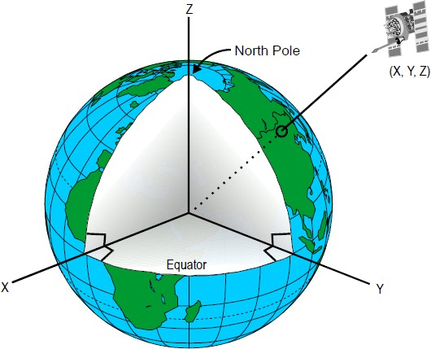
Reference Frames | ECIF
ECIF coordinate frame is fixed, Earth rotates about the z axis.
ℱ
ECIF
fixed w.r.t. stars, means that although the earth rotates about the z-axis, the x and y axes do not move.
x | fixed w.r.t. stars
y | fixed w.r.t. stars
z | true north
Earth-Centred Inertial Frame
慣性という名前は既に変わらない意味を持っていると思う。

Slide 13
Reference Frames | ECEF
ECEF coordinate frame rotates with the Earth.
ℱ
ECEF
x | prime meridian（本初子午線、ほんしょしごせん） (on equator(赤道、せきどう))
y | RHR（right-hand rule）
z | true north
Earth-Centred Earth-Fixed Frame

Slide 14





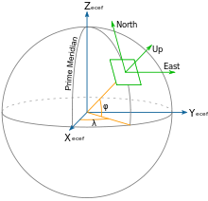
Reference Frames | Navigation
Although the ECEF and ECIF are useful when discussing satellites and inertial sensing onboard aircraft, for a practical car applications, usually want to use a frame that is fixed w.r.t. the ground.
ℱ
nav
NED Frame
ENU Frame
x | True North
y | True East
z | Down (along gravity)
x | East
y | North
z | Up
両フレームは共に右手の法則によってzが決まっている。

Slide 15
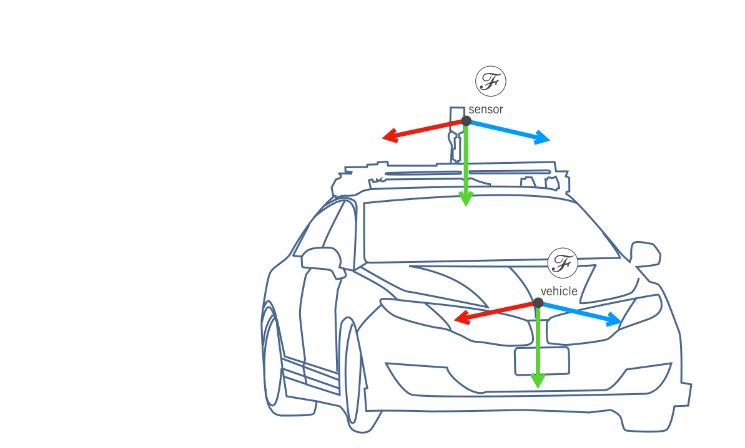
Reference Frames | Sensor & Vehicle
For localization, often ignore the distinction between the vehicle and sensor frame and assume that if can track the sensor, can track any point on the vehicle, given proper calibration.

Slide 16
Summary | 3D Geometry and Reference Frames
Vector quantities can be expressed in different reference frames
Rotations can be parametrized by rotation matrices, quaternions or Euler angles
ECEF, ECIF and Navigation frames are important in localization

Slide 17
Module 3 | Lesson 2
THE INERTIAL MEASUREMENT UNIT

Slide 18
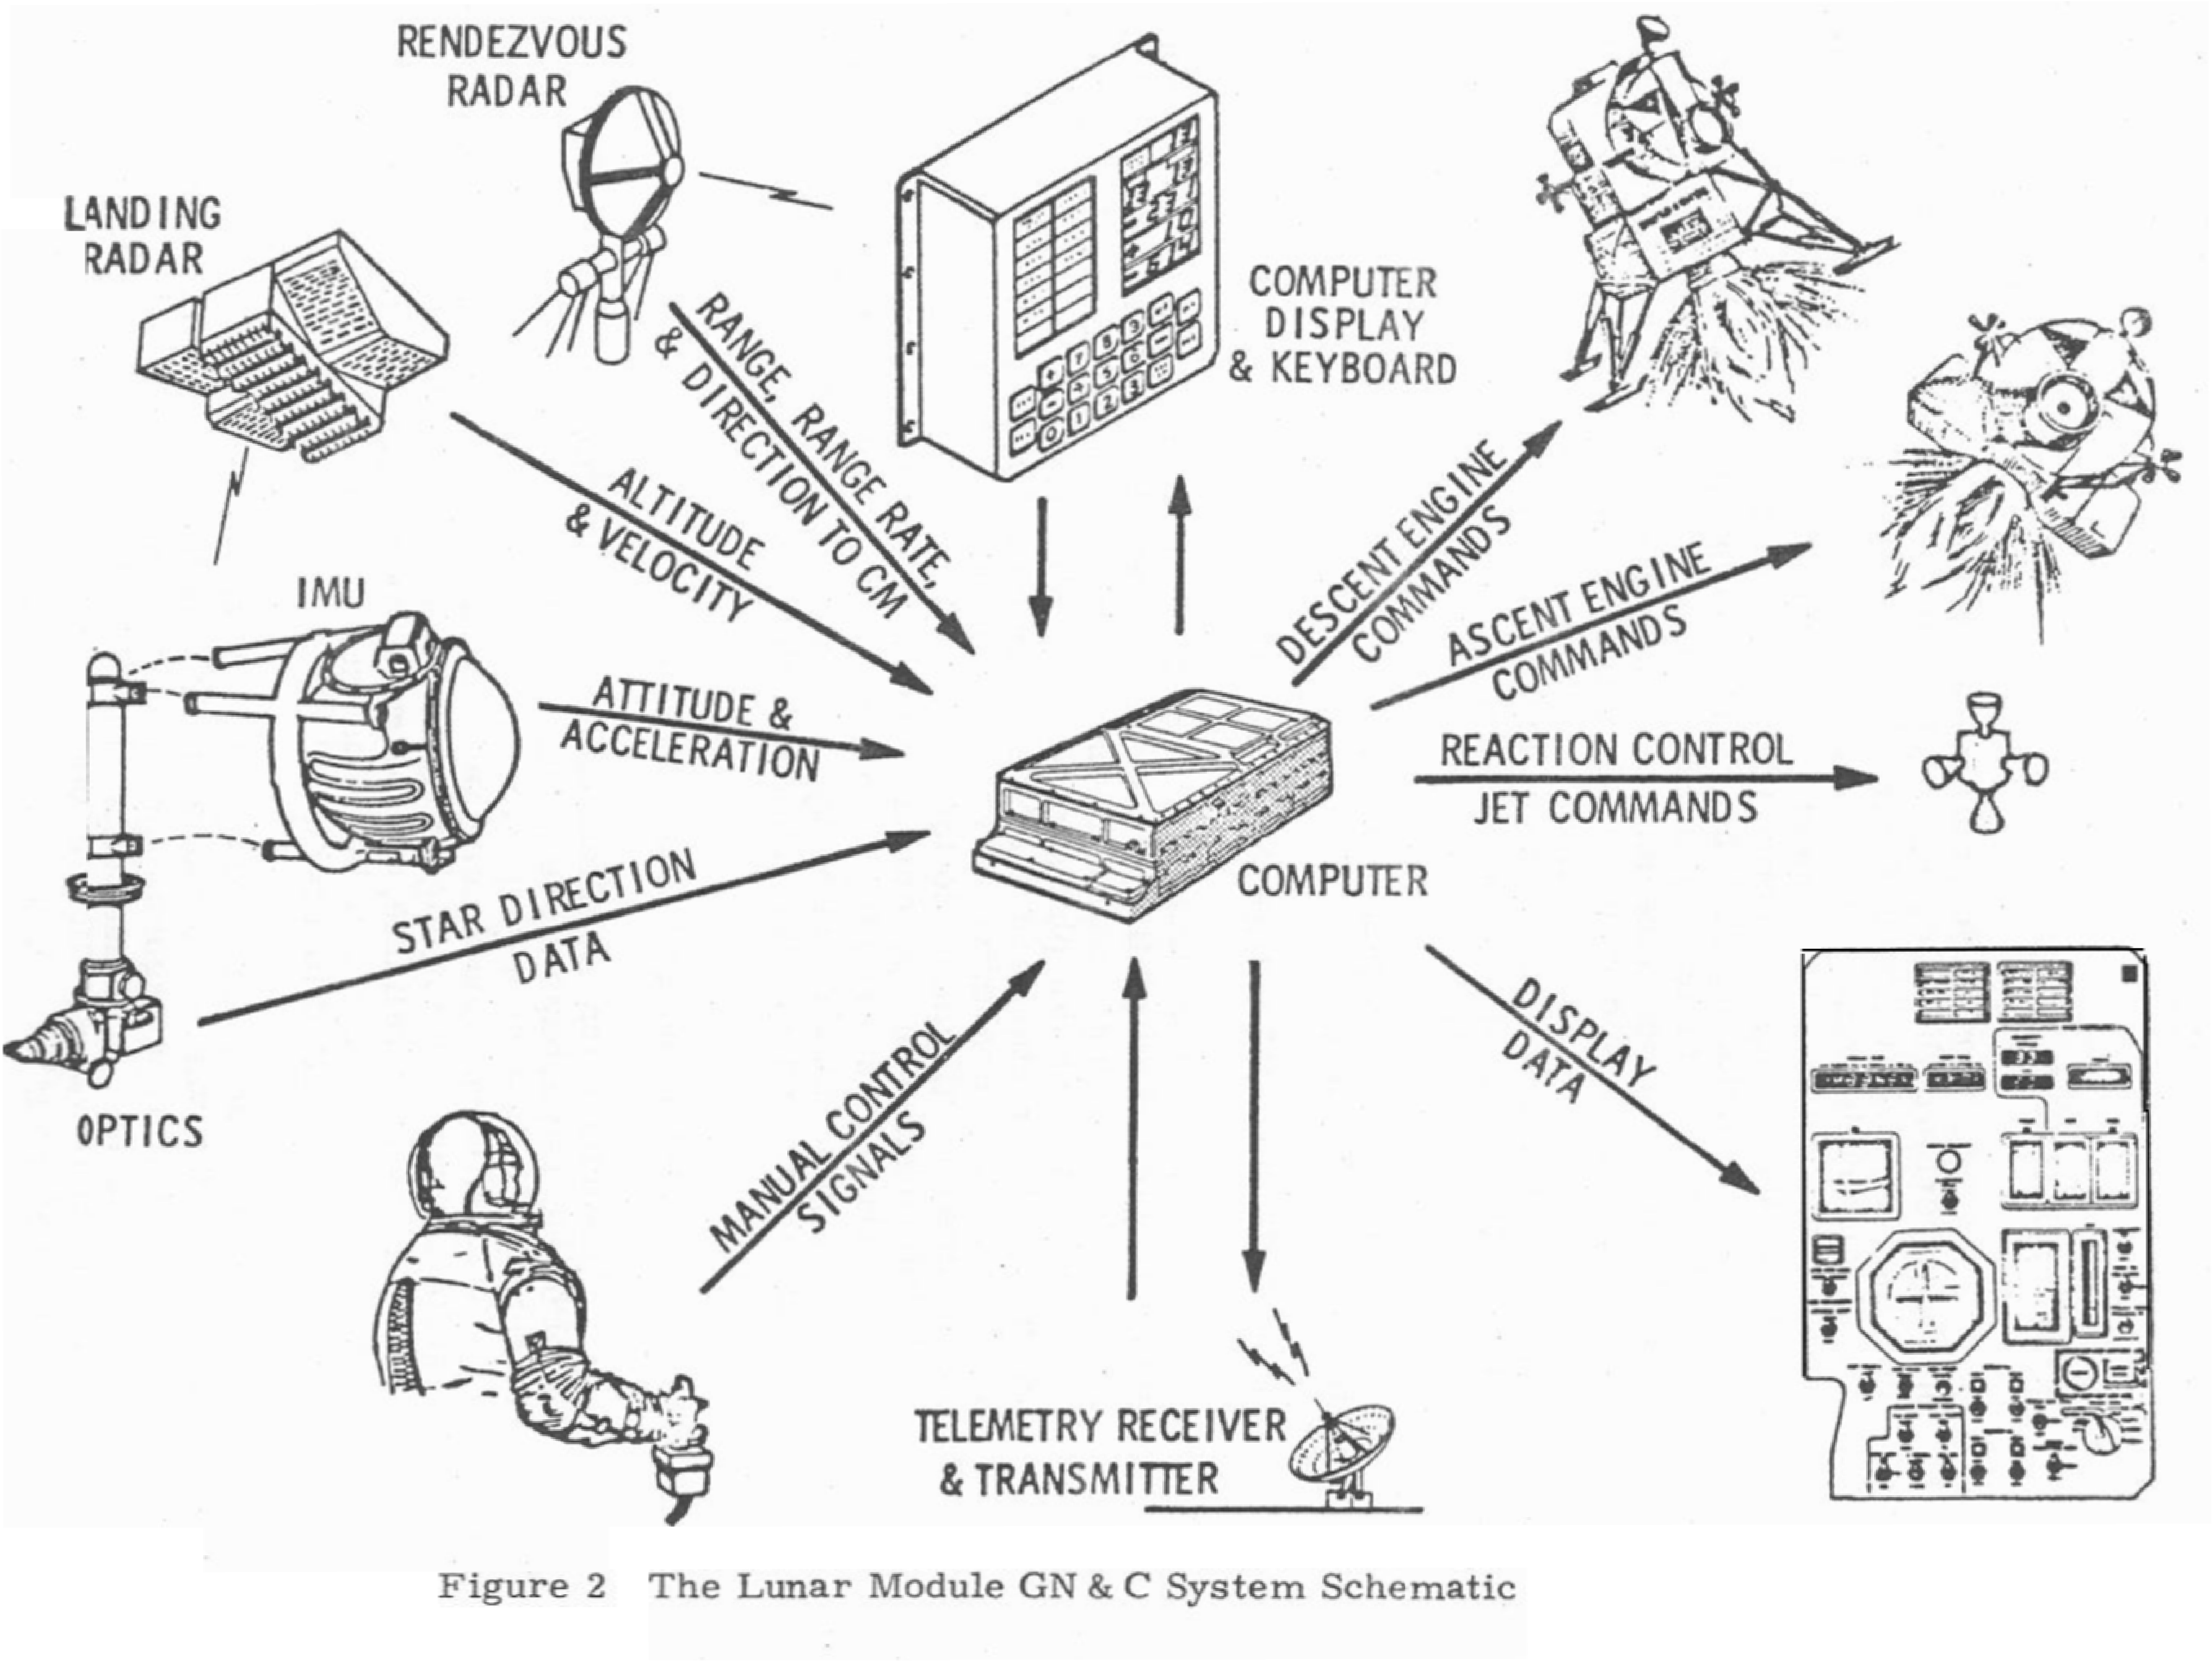
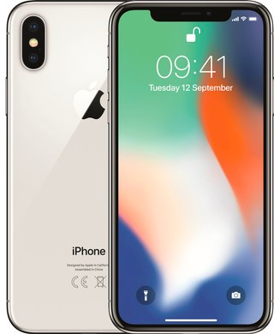
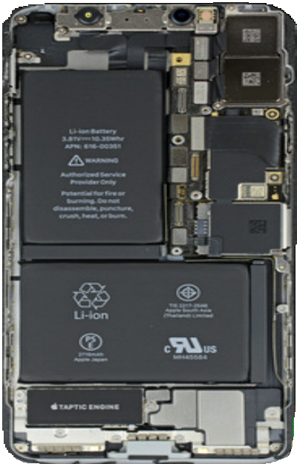
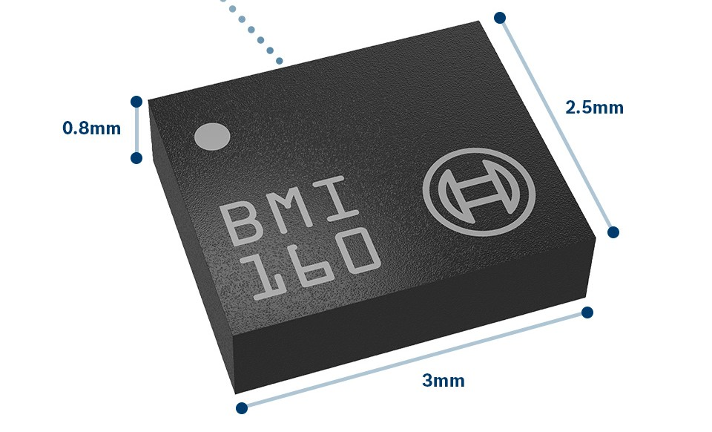
The Inertial Measurement Unit
In space there are few landmarks（ランドマーク） to rely on for guidance.
In modern self-driving cars, IMUs play a very similar role.
Filling in during periods when navigation information from other sensors is either unavailable or unreliable.
iPhone X IMU
Apollo Lunar Module Guidance Navigation & Control

Slide 19
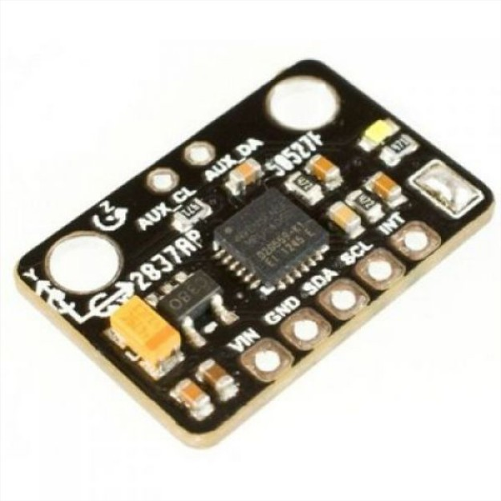
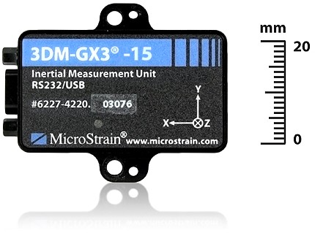
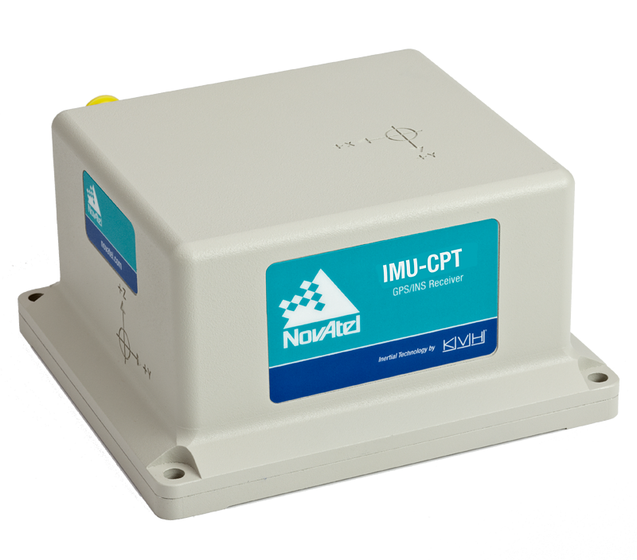
The Inertial Measurement Unit
An IMU is typically composed of
Gyroscopes（ジャイロスコープ） (measure angular rotation rates about three separate axes)
accelerometers (measure accelerations along three orthogonal(直交) axes)
IMUs come in many form factors; cost varies from ~$10 to ~$100K+
More expensive IMUs use more complex components and have more accurate calibration models that can remove the effects of temperature fluctuations, for example.

Slide 20
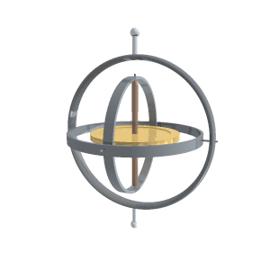
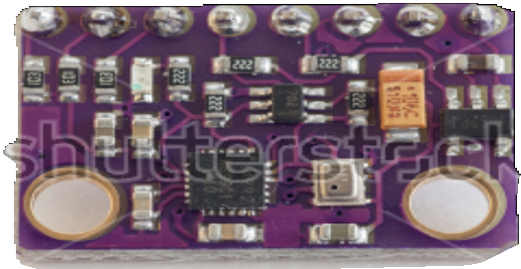
The Gyroscope
Gyroscope: γῦρος gûros, “circle” + σκοπέω skopéō, “to look”
Historically: a spinning disc that maintains a specific orientation relative to inertial space, providing an orientation reference
Modern spinning-disk gyroscopes spin at up to 24,000 RPM!
Microelectromechanical systems (MEMS) are much smaller and cheaper
Measure rotational rates instead of orientation directly
Measurements are noisy and drift over time
due to angular momentum（角運動量）, resist changes in orientation.
MEMS consists of a small silicon tuning fork that changes its resonance（共振） properties based on an applied rotation or orientation change.

Slide 21
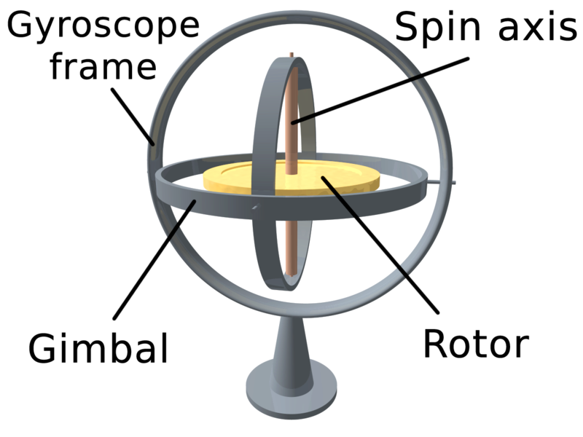
角運動量保存の法則（https://ja.wikipedia.org/wiki/%E8%A7%92%E9%81%8B%E5%8B%95%E9%87%8F%E4%BF%9D%E5%AD%98%E3%81%AE%E6%B3%95%E5%89%87）
この特別な場合として、外力が働かない（もしくは外力が働いていたとしてもそれによるトルクが0の）場合、質点系の角運動量は常に一定である。
例えば、フィギュアスケートの選手がスピンをする際、前に突き出した腕を体に引きつけることで回転が速くなる（角速度が大きくなる）。
このとき回転軸から腕先までの距離が短くなるため、かわりに回転が速くなることによって、角運動量が一定に保たれる。
A set of three gimbals, one mounted on the other with orthogonal pivot axes, may be used to allow a wheel mounted on the innermost gimbal to have an orientation remaining independent of the orientation, in space, of its support. （３つジンバルの回転軸が直交しているので、回転はお互いに独立）
ローター
https://en.wikipedia.org/wiki/Gyroscope
It is a spinning wheel or disc in which the axis of rotation (spin axis) is free to assume any orientation by itself.
When rotating, the orientation of spin axis is unaffected by tilting (傾ける) or rotation of the mounting, according to the conservation of angular momentum（角運動量）.

Slide 22

The Accelerometer
Accelerometers measure acceleration relative to free-fall（自由落下） - this is also called the proper acceleration or specific force:
An accelerometer measures acceleration along a single axis.
Springs
Acceleration
^{F}non−gravity
m
Mass
a
meas ^{= f =}
C1 C2
Sitting still at your desk, your proper acceleration is g upwards! (think of the ‘normal’ force holding you up)
Fixed plates
In localization, we typically require the acceleration relative to a fixed reference frame
‘coordinate’ acceleration
computed using fundamental equation for accelerometers in a gravity field:
f + g = ·r·_{i}
地面をリファレンスとした加速度

Slide 23

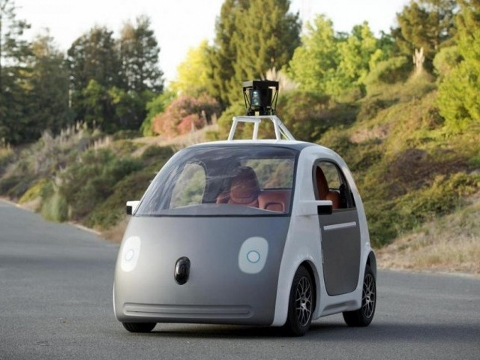

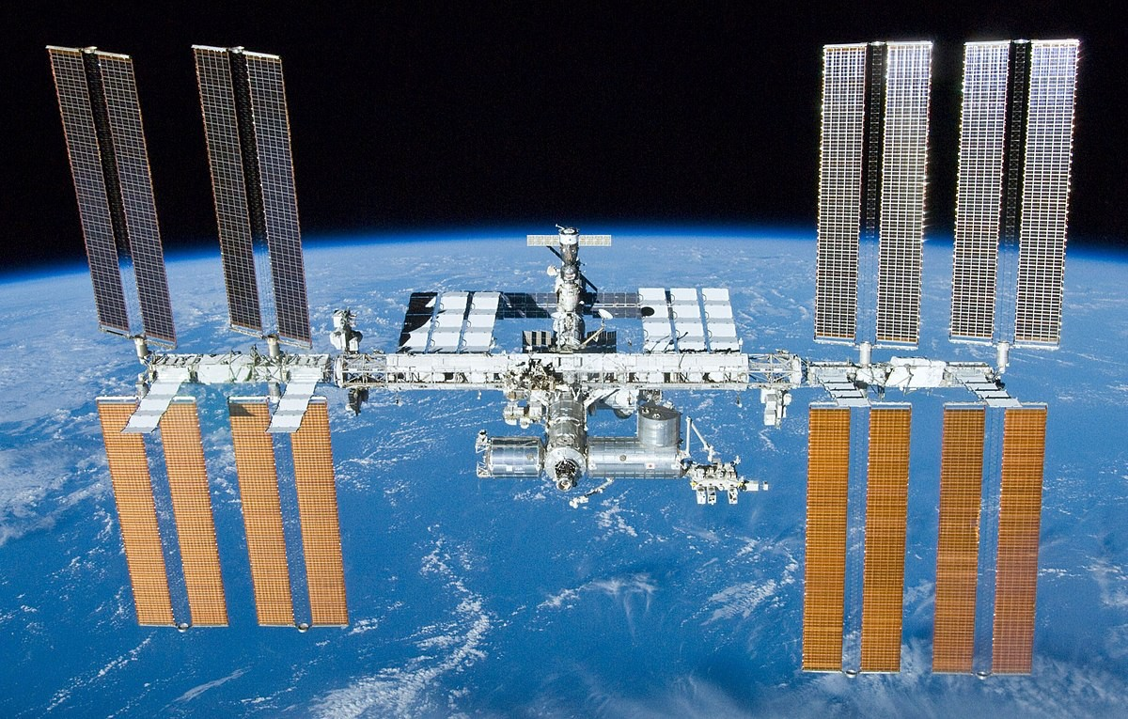
The Accelerometer | Examples
An accelerometer in a stationary car measures:
fはaccelerometerの観測値
f = ·r·_{i} − g ≈ 0 − g ≈ − g
g ‘up’
An accelerometer on the International Space Station（宇宙ステーション） measures:
f = ·r·_{i} − g ≈ g − g ≈ 0
(zero-g!)

Slide 24
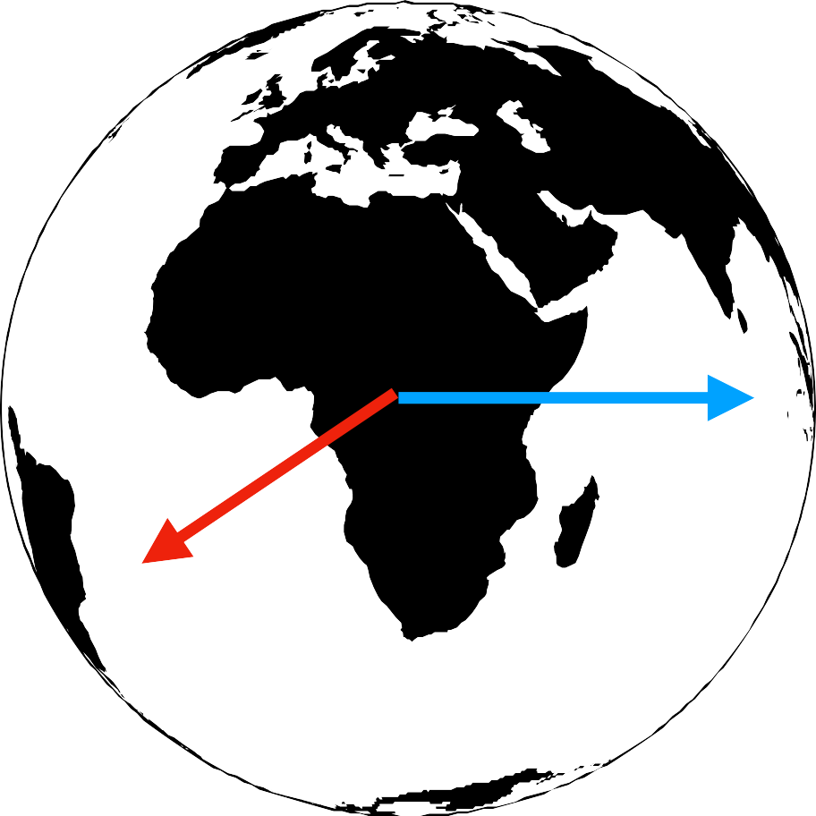


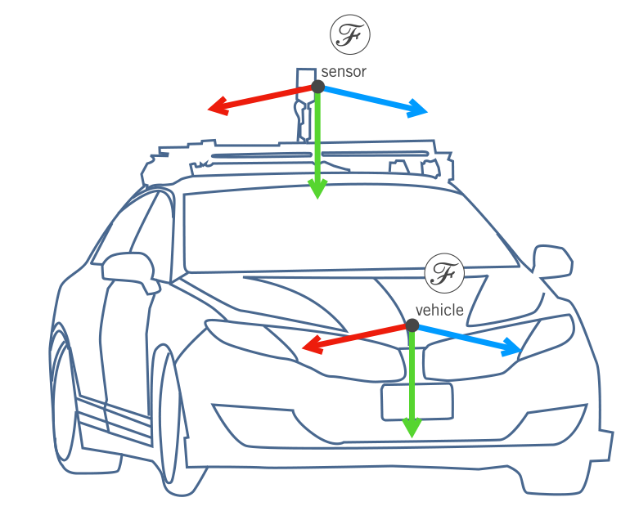
Measurement Model: Gyroscope
ℱ
n
ω(t) = ω_{s}(t) + b_{gyro}(t) + n_{gyro}(t)
ω_{s}(t)
b_{gyro}(t) n_{gyro}(t)
angular velocity of the sensor expressed in the sensor frame.
slowly evolving bias
noise term
Although gyroscopes do measure the rotation of the Earth, it’s often safe to ignore this for applications where we care only about motion over a short duration.

Slide 25

Measurement Model: Accelerometer
ℱ
n
加速度計の観測値はセンサーフレーム上
自車の加速度はnavigation frame上
a(t) = C_{sn}(t)(·r^{·sn}(t) − g ) + b
(t) + n (t)
n n accel
accel
C_{sn}(t)
orientation of the sensor (computed by integrating the rotational rates from the gyroscope)
^{b}accel^{(t)}
^{n}accel^{(t)} g_{n}
bias term
noise term
gravity in the navigation frame
Since the accelerometers measure acceleration in the IMU body frame, need to keep track of the orientation at all times in order to be able to perform the necessary subtraction.
An accurate orientation estimate is critical for accurate position estimates.
When we convert the measured specific force into an acceleration, have to make sure that the direction of gravity is correct.
Otherwise even a small error in orientation can cause us to think that we’re accelerating when we’re not.

Slide 26
Inertial Navigation: Important Notes
When using an IMU for localization, keep in mind:
1. If we inaccurately keep track of C (t), we incorporate components of g
into ·r^{·sn}(t)
sn
r^{sn}(t)).
n
n
This will ultimately lead to terrible estimates of position (
n
Both measurement models ignore the effect of Earth’s rotation.
We only consider strapdown（ストラップダウン、吊り下げ式） IMUs- where the individual sensors are rigidly attached to the vehicle and are not gimballed（ジンバルのようではなく）.
（つまり観測値はセンサーフレーム上の値だと思う）

Slide 27
Summary | The Inertial Measurement Unit
A 6-DOF IMU is composed of three gyroscopes and three accelerometers, mounted orthogonally.
A strapdown gyroscope measures a rotational rate in the sensor frame.
A strapdown accelerometer measures a specific force (or acceleration relative to free-fall) in the sensor frame.
Since strapdown IMUs are tricky to calibrate and drift over time, need another sensor to periodically correct the pose estimates.

Slide 28
Module 3 | Lesson 3
GLOBAL NAVIGATION SATELLITE SYSTEMS

Slide 29
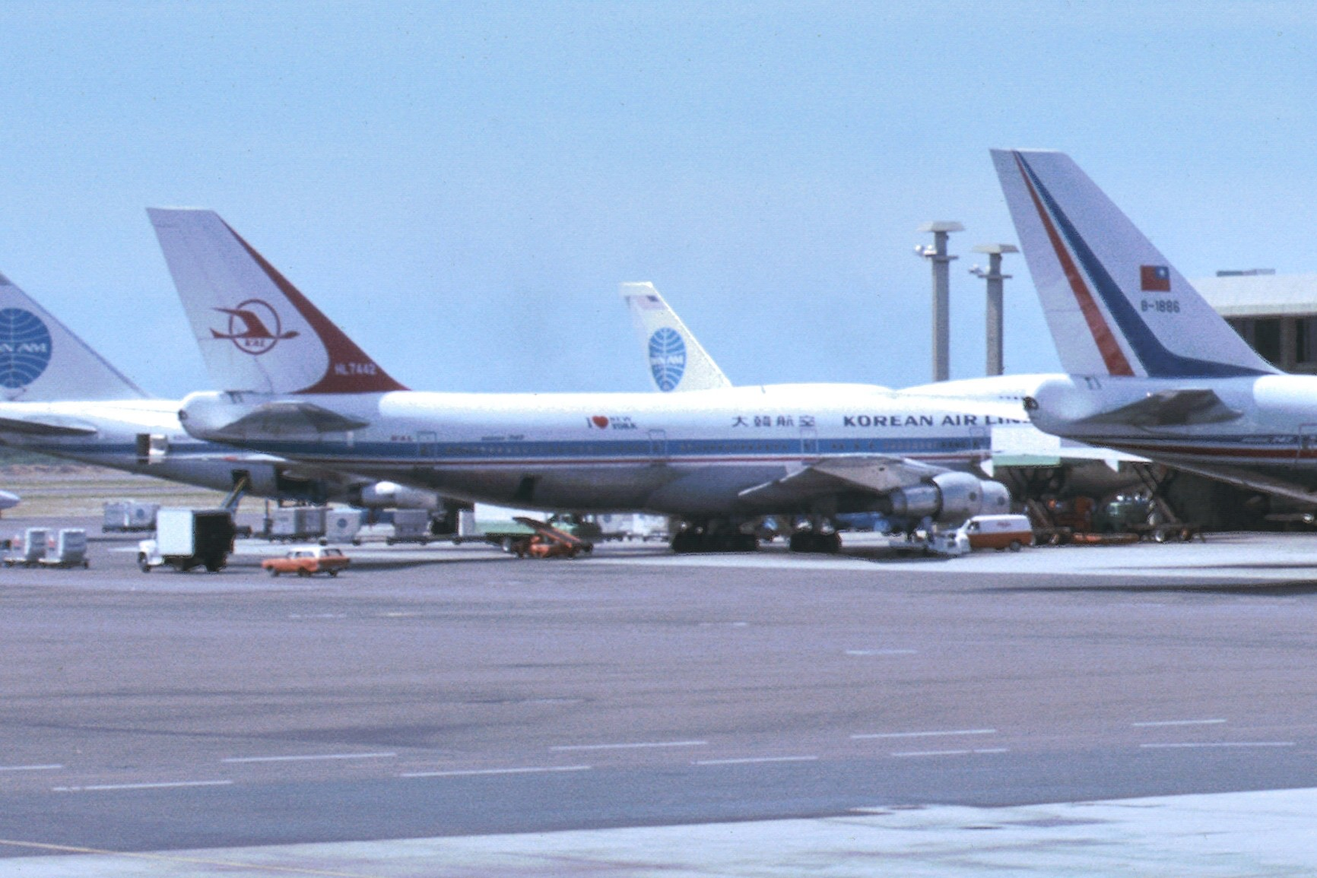
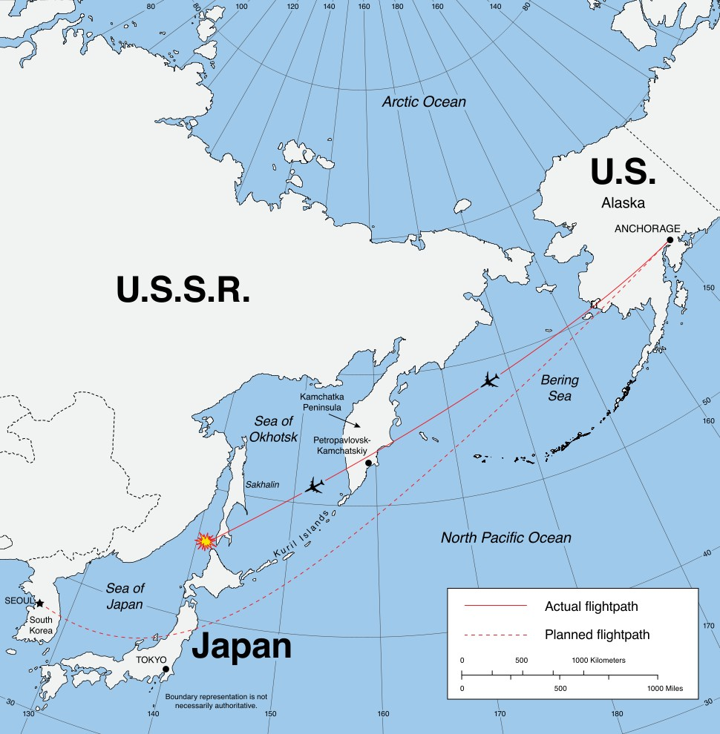
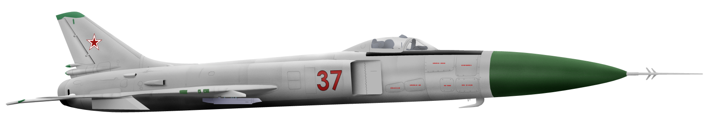
Korean Air Lines Flight 007
Korean Air Flight 007 was shot down in 1983 after deviating into Soviet(ソ連) airspace(領空、りょうくう) due to improper use of their Inertial Navigation System.
This prompted the U.S. to open GPS for worldwide use.

Slide 30
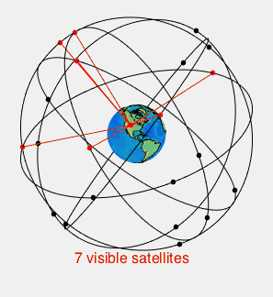
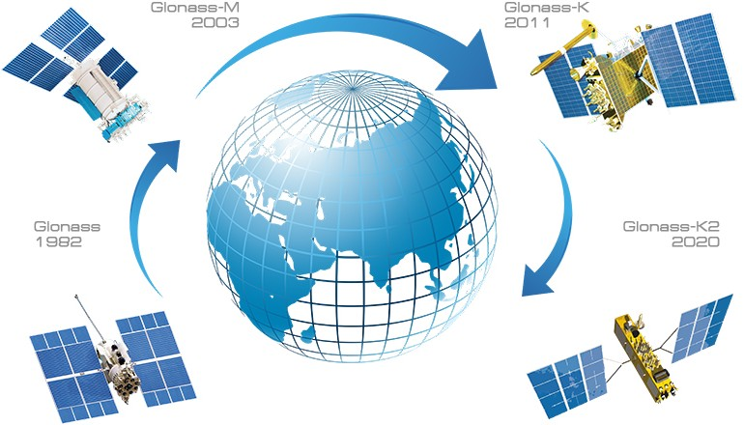
GNSS | Accurate Global Positioning(測位)
Global Navigation Satellite System (GNSS) is a catch-all term for a satellite system(s) that can be used to pinpoint a receiver’s position anywhere in the world
Globalnaya navigatsionnaya sputnikovaya sistema (GLONASS)
Global Positioning System (GPS)
The two that are fully operational as of 2018 are GPS and GLONASS, the Russian equivalent.
Several other systems are nearing completion, including the European Galileo(ガリレオ) constellation（星座、集まり）.

Slide 31
GPS | Global Positioning System
Composed of 24 to 32 satellites in 6 orbital planes
Altitude of ~20,200 km (12,550 miles)
Orbital period of ~12 hours
Each satellite broadcasts on two frequencies:
L1 (1575.42 MHz, civilian + military)
L2 (1227.6 MHz, military)
Satellites are decommissioned and replaced periodically.
The constellation is designed such that at least 4 satellites are visible at any surface point on earth at all times.

Slide 32
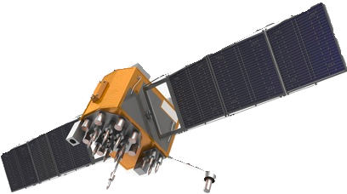
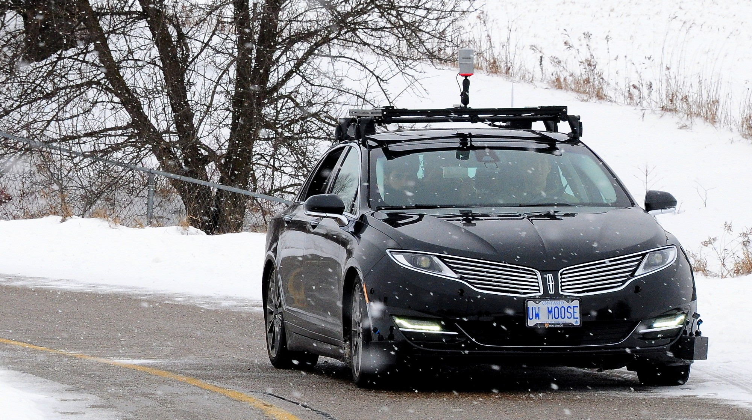
GPS | Computing Position
Each GPS satellite transmits a signal that encodes
its position
(via accurate ephemeris（天体歴） information)
time of signal transmission (via onboard atomic clock（原子時計）)
To compute a GPS position fix in the Earth-centred frame, the receiver uses the speed of light（光速） to compute distances to each satellite based on time of signal arrival
At least four satellites are required to solve for 3D position, three if only 2D is required (e.g., if altitude is known)
Each broadcast signal contains a pseudo-range code that identifies the satellite position and the time of transmission of the signal.
The basic principle behind GPS is time of arrival ranging.
The receiver computes a distance to each visible satellite by comparing its own internal clock with that of the time of transmission.
The time difference is converted to a distance using knowledge that electromagnetic signals propagate at the speed of light.

Slide 33
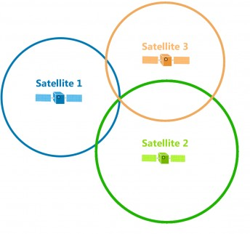

Trilateration（三辺測量、さんぺん）
The process of recovering position from several distances to known landmarks is called trilateration.
Triangulation（三角測量）とは違う。triangulation: compute positions based on angle measurements.
For each satellite, we measure the pseudorange（疑似距離、ぎじ） as follows:
ρ^{(i)} = c(t_{r} − t_{s}) = p
(i)
T
(i) (i)
(i)
− r p − r₎ + cΔt_{r} + cΔt + η
( ) (
a
方程式
receiver (3D) position p^{(i)} position of satellite Δt_{r} receiver clock error
r
_{ρ}(3)
_{ρ}(1)
Δt^{(i)} atmospheric propagation delay
_{ρ}(2)
a
measurement noise speed of light
t_{s}, t_{r} time sent, time received
η
c
Trilateration in 2D
The term pseudo range refers to the fact that the range information is corrupted by the error sources above.
Each pseudo range measurement defines a circle in 2D or a sphere in 3D.

Slide 34
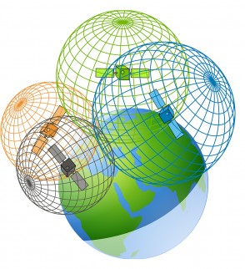
Trilateration
By using at least 4 satellites, we can solve for:
r receiver (3D) position
Δt_{r} receiver clock error
多分ΔtrとΔtaの和を得ると思う。
If more than 4, can use method of least squares to find the maximum likelihood position assuming Gaussian noise.
Multilateration in 3D

Slide 35
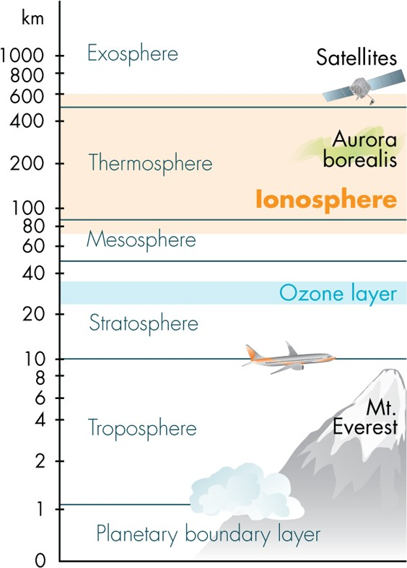
GPS | Error Sources (I)
外気圏
Ionospheric（電離層） delay
Charged ions（イオン） in the atmosphere affect signal propagation
Multipath effects
Surrounding terrain, buildings can cause unwanted reflections
(unknown amount)
熱圏、ねつけん
電離層
中間圏
オゾン層
成層圏
Increase the distance traveled by the signal before reaching the receiver.
Radarも同じ課題があると思う
対流圏
大気境界層、たいき

Slide 36
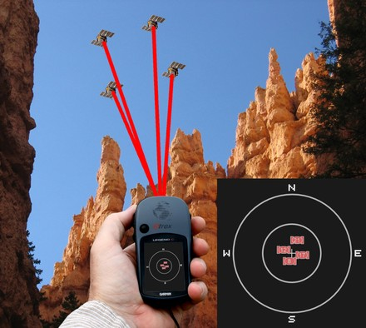
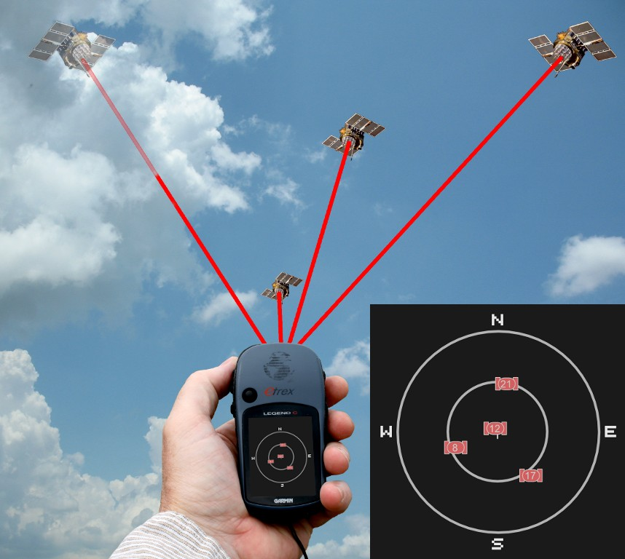
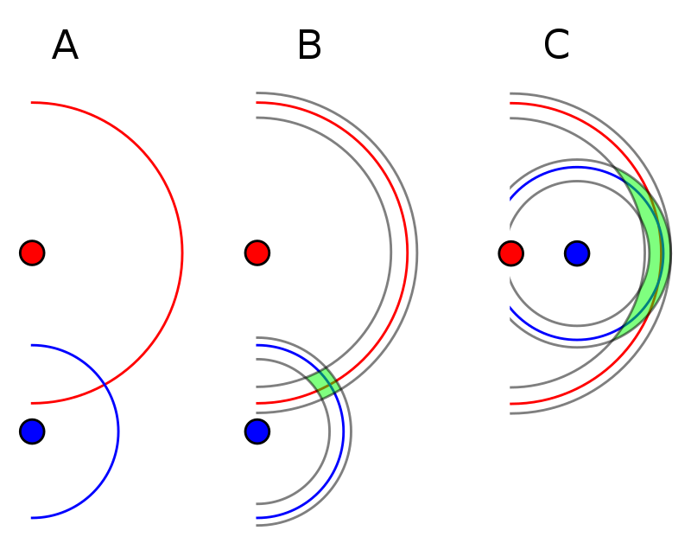
GPS | Error Sources (II)
ephemeris: 天体暦。a table giving the future positions of a planet, comet（彗星、すいせい）, or satellite. 衛星の位置情報は天体歴から貰ったと思う。
Ephemeris（天体歴） & clock errors
A clock error of 1 × 10⁻⁶ s gives a 300 m position error!
Geometric Dilution（希釈、きしゃく） of Precision (GDOP)
The configuration of the visible satellites affects position precision.
Any small error in clock synchronization or satellite position information can have catastrophic consequences.
Both a Ephemeris data and satellite clocks are updated and recalibrated often, but the calibration can be out of date.
Poor config - high GDOP
Good config - low GDOP
For higher accuracy, a configuration with satellites spread across the sky is preferable.
https://en.wikipedia.org/wiki/Dilution_of_precision_(navigation)

Slide 37
GPS | Improvements
Differential GPS can correct receiver positioning estimates by making use of the more accurately known positions of one or more fixed base stations.
Corrections are broadcast on separate frequencies to the GNSS receiver in the moving vehicle.
Real-Time Kinematic, or RTK GPS makes use of carrier phase（搬送波位相） information to improve positioning accuracy.
Typically quite costly to implement.
Differential GPS (DGPS)
Real-Time Kinematic (RTK) GPS
Basic GPS
mobile receiver | mobile receiver + fixed base station(s)(基地局、きち) | mobile receiver + fixed base station
no error correction | estimate error caused by atmospheric effects | estimate relative position using phase of carrier signal（搬送波位相）
~10 m accuracy | ~10 cm accuracy | ~2 cm accuracy

Slide 38
Summary | The Global Navigation Satellite System
A GNSS works through trilateration via pseudoranging from at least 4 satellites (for a 3D position fix).
GNSS error can be caused by ionospheric delays, multipath effects, and precision is also affected by GDOP.
For GPS, differential GPS and RTK GPS are potential methods to substantially improve performance.

